Slide 1
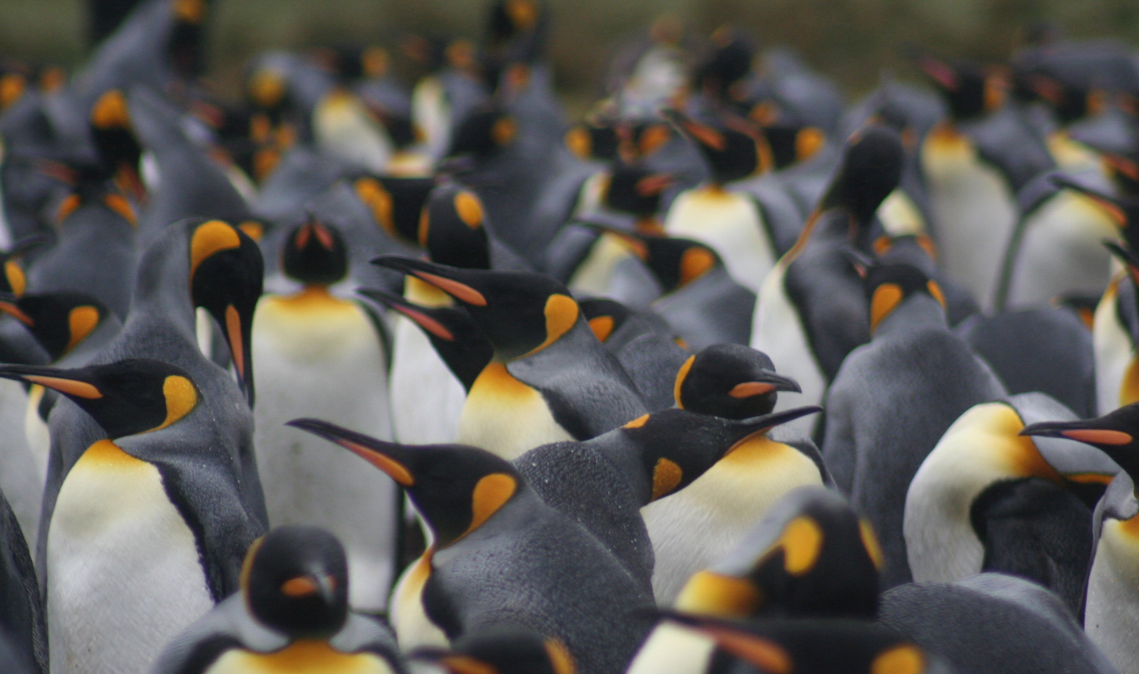
Optimal foraging under predation risk

Slide 2
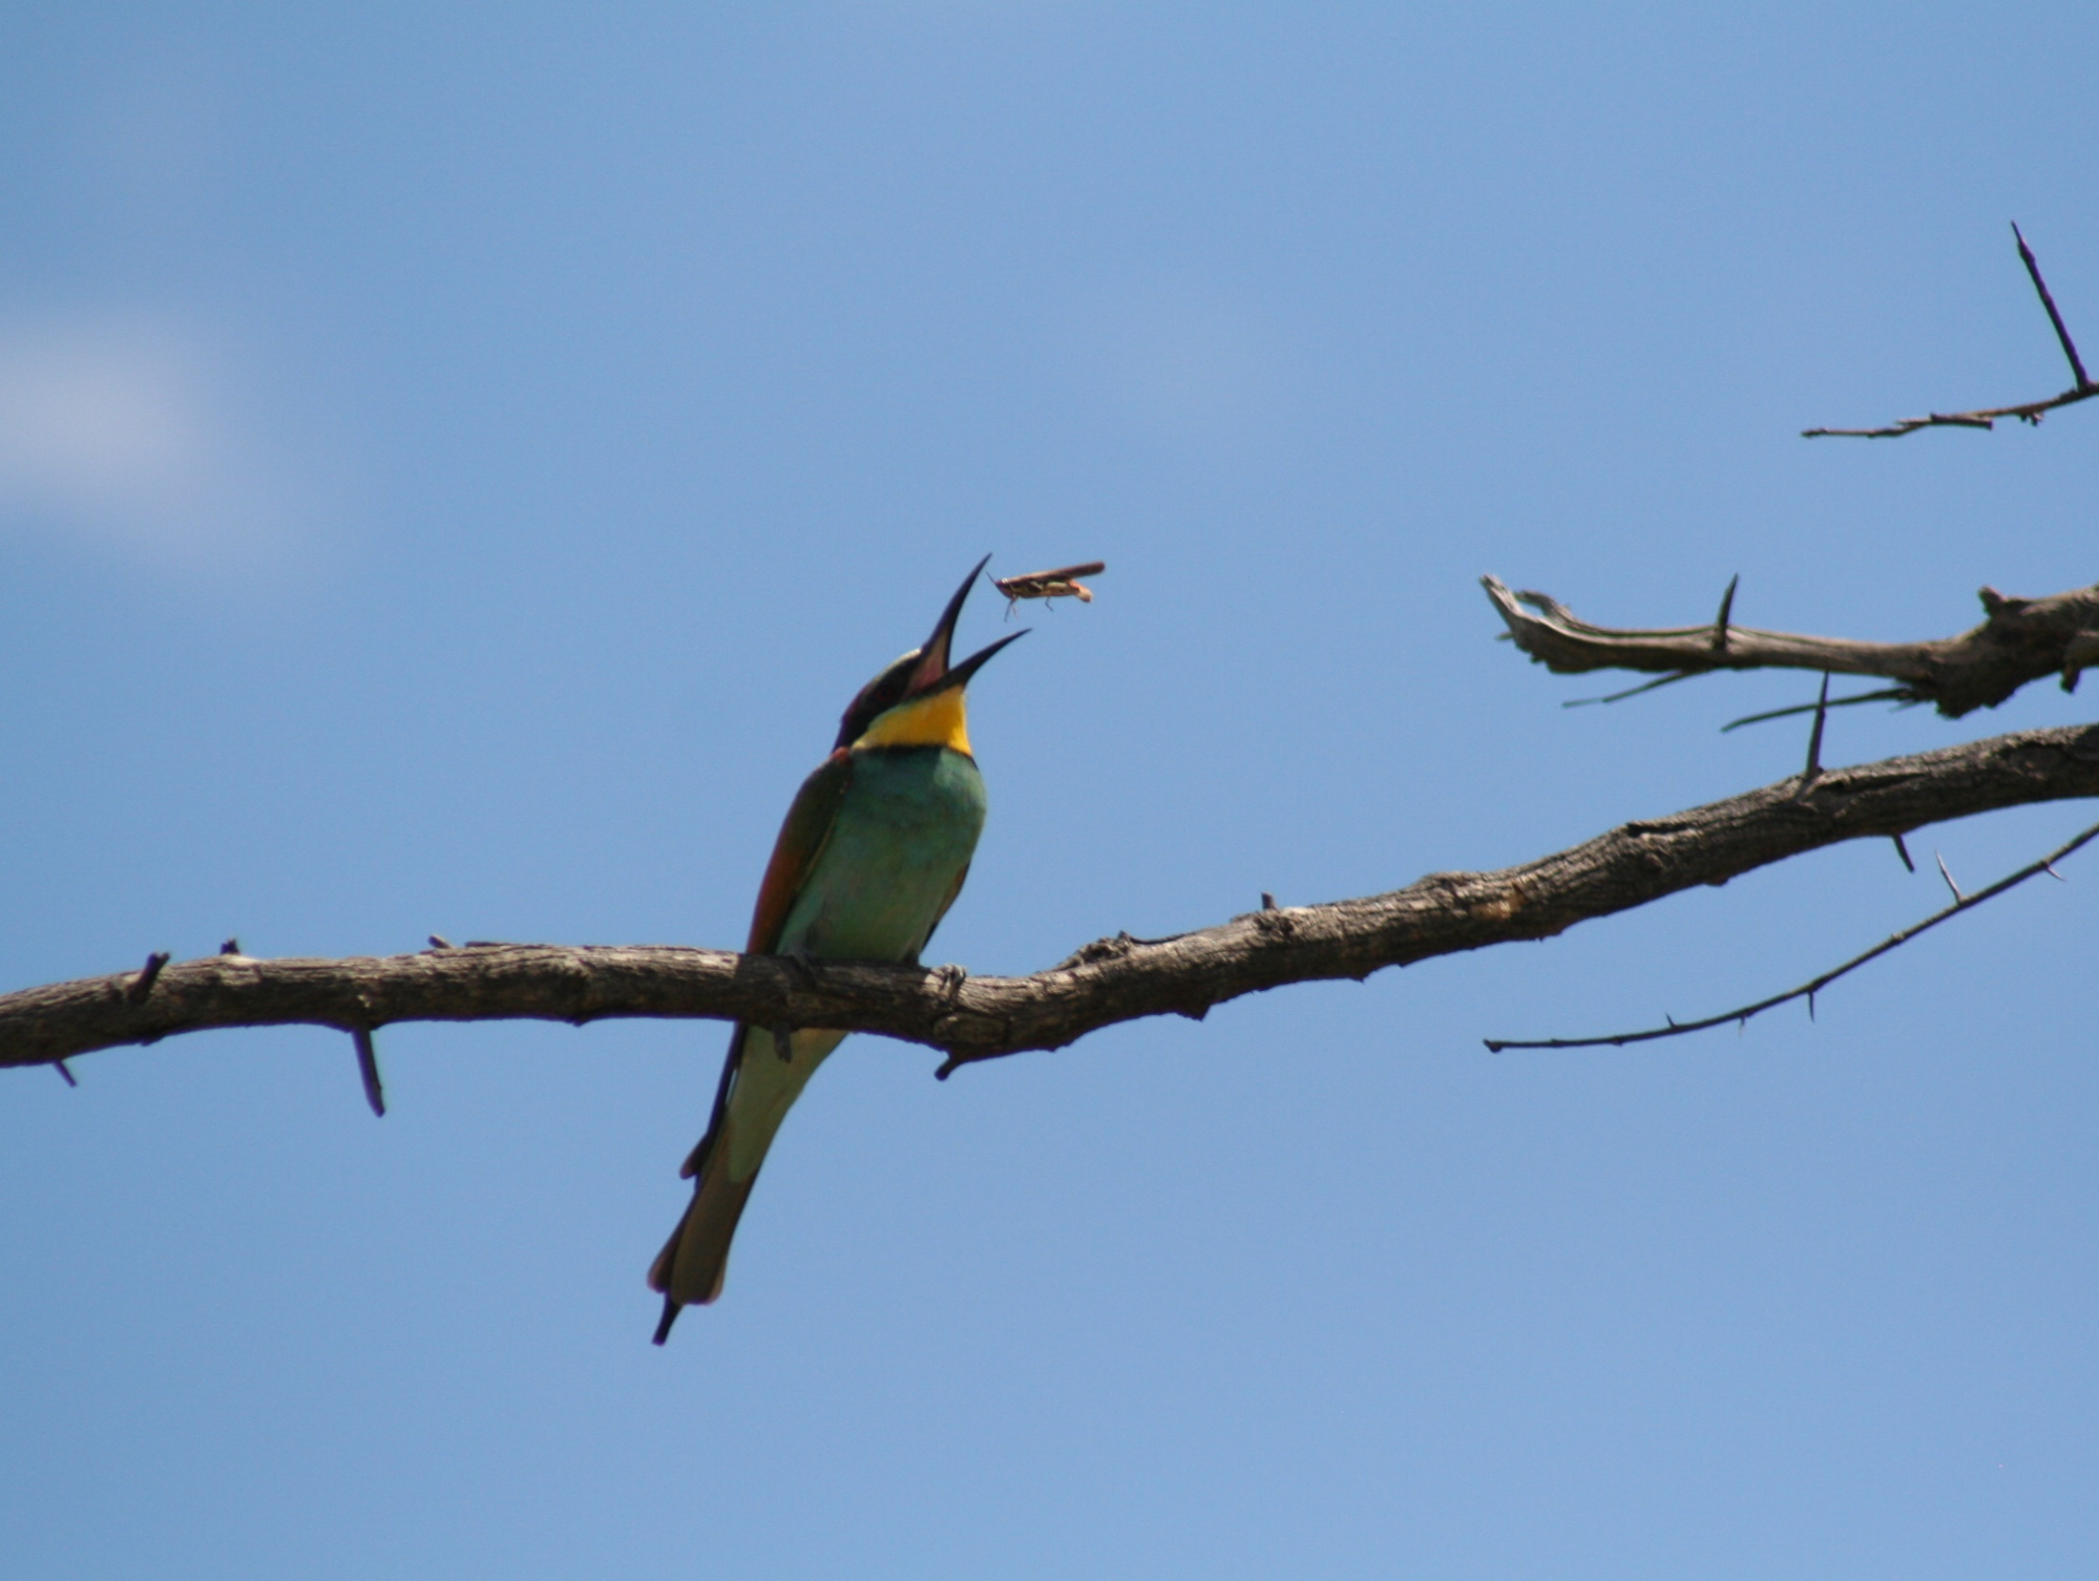
Basic assumption of optimal foraging theory:
Assumes that natural selection has resulted in foraging behavior that maximizes fitness
(Houston & McNamara 2013, J. Anim. Ecol.)

Slide 3
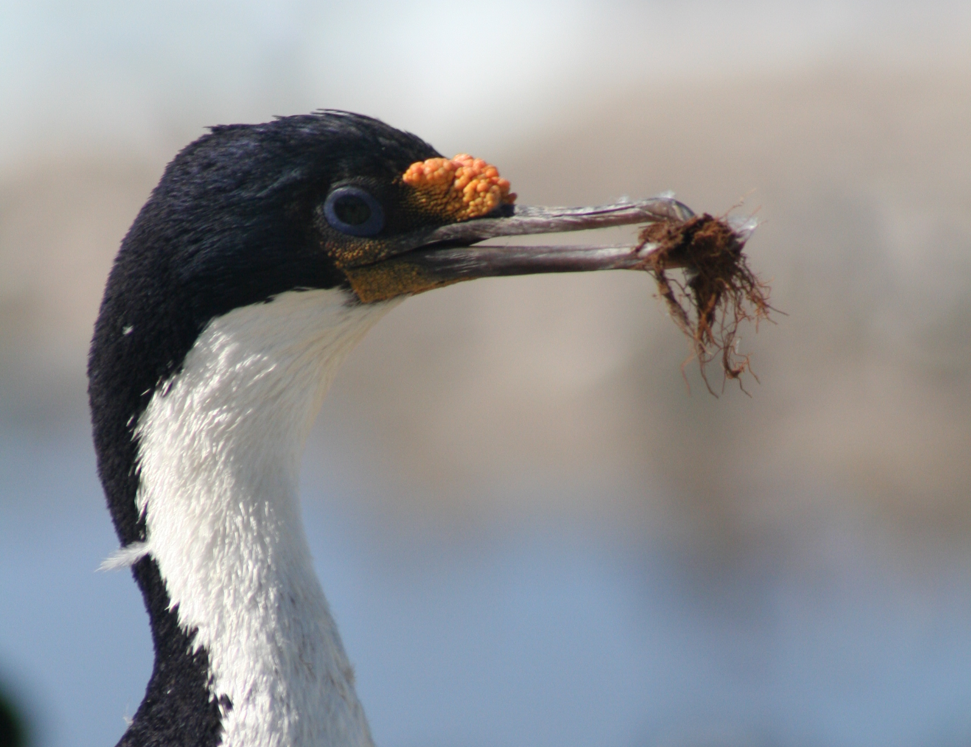
Basic elements optimality models
Choose the option maximizing a currency, given the constraints
Among the most influential models:
Marginal value theorem: how long to forage in patch (Charnov 1976)
Contingency model of optimal diet: what should be consumed (MacArthur & Pianka 1966)

Slide 4
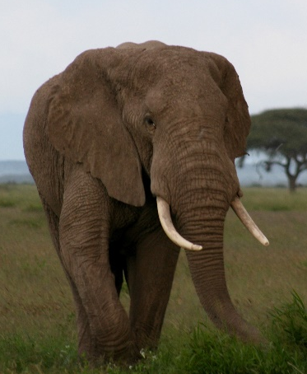
Optimal patch departure time
Marginal value theorem
Charnov, E.L. 1976. Optimal foraging: the marginal value theorem.
Theoretical Population Biology 9:129-136.
Cumulative gain rate, g(t)
g(t)
S + t
R(t) =
-10 -5 0 5 10 15 20
Travel time, S
Foraging time in the patch, t
Notes:
Probably the most influencial functional response – been wildely use to model carnivore-herbivore relationship

Slide 5
Optimal patch departure time
Marginal value theorem
Charnov, E.L. 1976. Optimal foraging: the marginal value theorem.
Theoretical Population Biology 9:129-136.
Cumulative gain rate, g(t)
Optimal residence time
-S
t*
-10 -5 0 5 10 15 20
Travel time, S
Foraging time in the patch, t
Notes:
Probably the most influencial functional response – been wildely use to model carnivore-herbivore relationship

Slide 6
Optimal patch departure time
Marginal value theorem
Lower average time to move between patches
Cumulative gain rate, g(t)
-T
t*
-10 -5 0 5 10 15 20
Travel time, S
Foraging time in the patch, t
Notes:
Probably the most influencial functional response – been wildely use to model carnivore-herbivore relationship

Slide 7
Optimal patch departure time
Marginal value theorem
Lower performance of the consumer
-T
t*
-10 -5 0 5 10 15 20
Travel time, S
Foraging time in the patch, t
Notes:
Probably the most influencial functional response – been wildely use to model carnivore-herbivore relationship

Slide 8

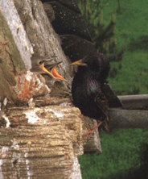
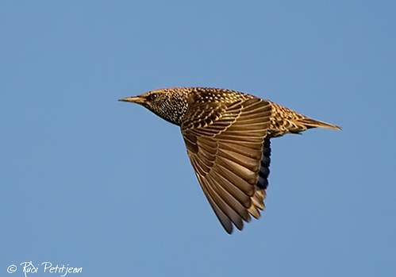
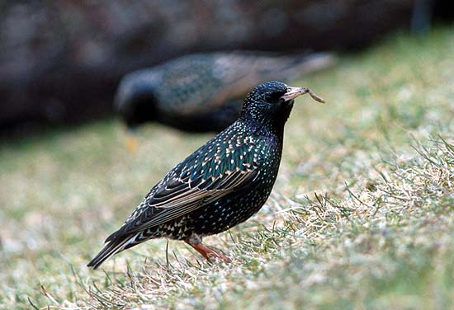
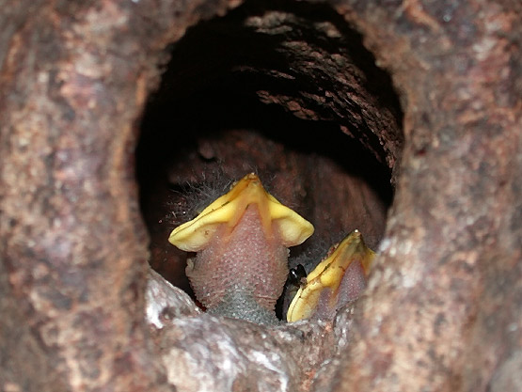
Optimal patch departure time
Marginal value theorem
Mealworms (larvae of Tenebrio molitor)
Variation in mealworm load size, given the distance from the nest
Kacelnik (1984, Journal of Animal Ecology 53: 283-299)
Notes:
Probably the most influencial functional response – been wildely use to model carnivore-herbivore relationship

Slide 9
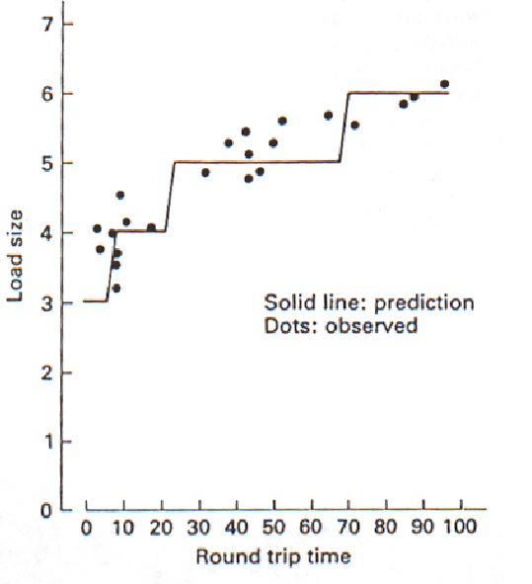
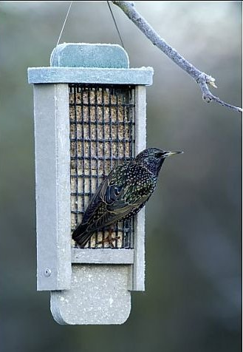
Optimal patch departure time
Marginal value theorem
Place feeding trays with mealworms at different distances from the nest
Induce a decrease in worm capture rate with time spent in the patch; he manipulated the gain function
How should load size vary with the distance from the nest
Model predicts larger loads with longer travel times
Kacelnik (1984, J. Anim. Ecol. 53: 283-299)
Notes:
Probably the most influencial functional response – been wildely use to model carnivore-herbivore relationship

Slide 10

Optimal diet choice: the contingency model
MacArthur RH, Pianka ER (1966) On the optimal use of a patchy environment. American Naturalist 100 (916): 603–9

Slide 11
Estimation of the rate of energy intake
F
E =
e
= e I
T_{f}
E: Energy intake rate (kJ / min), F: Number of prey consumed (prey),
T_{f}: Total foraging time (min), e: Energy content
F / T_{f} = I = Prey intake rate (prey / min)
Energy intake rate = (Intake rate of a given prey type) x (energy content)
Related to functional responses
Notes:
Ask them

Slide 12
Main types of functional response
I
III
II
Resource intake rate (resource/min)
Resource density (resources / m²)

Slide 13
Mechanistic functional response
F
aNT_{s}
I
I =
=
T_{f}
T_{s} + T_{h}
T_{f} = T_{s} + T_{h}
a: Search rate, e.g., area over which prey can detect per unit of time (m²/min)
Speed (m²/min) x detection radius (m)
N: Resource density (resources / m²)
T_{s}: Total time spent searching (min) during T_{f}
T_{h}: Total time species handling (min) during T_{f}
Notes:
Probably the most influencial functional response – been wildely use to model carnivore-herbivore relationship

Slide 14
Mechanistic functional response
F
aNT_{s}
I
I =
=
T_{f}
T_{s} + aNT_{s}×h
T_{f} = T_{s} + T_{h}
a: Search rate, e.g., area over which prey can detect per unit of time (m²/min)
Speed (m²/min) x detection radius (m)
N: prey density (prey/ m²)
T_{s}: Total time spent searching (min) during T_{f}
T_{h}: Total time species handling (min) during T_{f}
T_{h} = aNT_{s} x h,
where h: time needed to handle each prey (min / prey)
Notes:
Probably the most influencial functional response – been wildely use to model carnivore-herbivore relationship

Slide 15
Multispecies mechanistic functional response
Mechanistic functional response
aNT_{s}
aNT_{s}
I
=
I
=
T_{s} + aNT_{s}×h
T_{s} + aNT_{s}×h
M
i=1
M
i=1
Σ
Σ
aT_{s} (N_{i}p_{i})
a (N_{i}p_{i})
I
=
=
M
i=1
M
i=1
Σ
Σ
T_{s} + aT_{s} (N_{i}h_{i}p_{i})
1 + a (N_{i}h_{i}p_{i})
Where p_{i} indicates whether (value of 1) are not (value of 0) type i prey is consumed whenever encountered
What if multiple prey types can be consumed?
Notes:
Probably the most influencial functional response – been wildely use to model carnivore-herbivore relationship

Slide 16
Maximization of energy intake rate:
the contingency model
M
i=1
M
i=1
Σ
Σ
aT_{s} (N_{i}p_{i})
a (N_{i}p_{i})
I
=
=
M
i=1
M
i=1
Σ
Σ
T_{s} + aT_{s} (N_{i}h_{i}p_{i})
1 + a (N_{i}h_{i}p_{i})
We can estimate E for a diet of M resource types by multiplying e of each resource type following:
M
i=1
Σ
a (N_{i}p_{i}e_{i})
E
=
M
i=1
Σ
1 + a (N_{i}h_{i}p_{i})
Notes:
Probably the most influencial functional response – been wildely use to model carnivore-herbivore relationship

Slide 17
Maximization of energy intake rate:
the contingency model
M
i=1
Σ
a (N_{i}p_{i}e_{i})
E_{total}
=
M
i=1
Σ
1 + a (N_{i}h_{i}p_{i})
Let’s evaluate a diet comprised of two resource types:
a(N₁p₁e₁ + N₂p₂e₂)
E_{total}
=
1 +a(N₁h₁p₁ + N₂h₂p₂)
Assumes that the profitability of type 1 resource is higher than that for type 2 resource, i.e., e₁/h₁ > e₂/h₂. Which diet would then yield the maximum energy gain?
Notes:
Probably the most influencial functional response – been wildely use to model carnivore-herbivore relationship

Slide 18
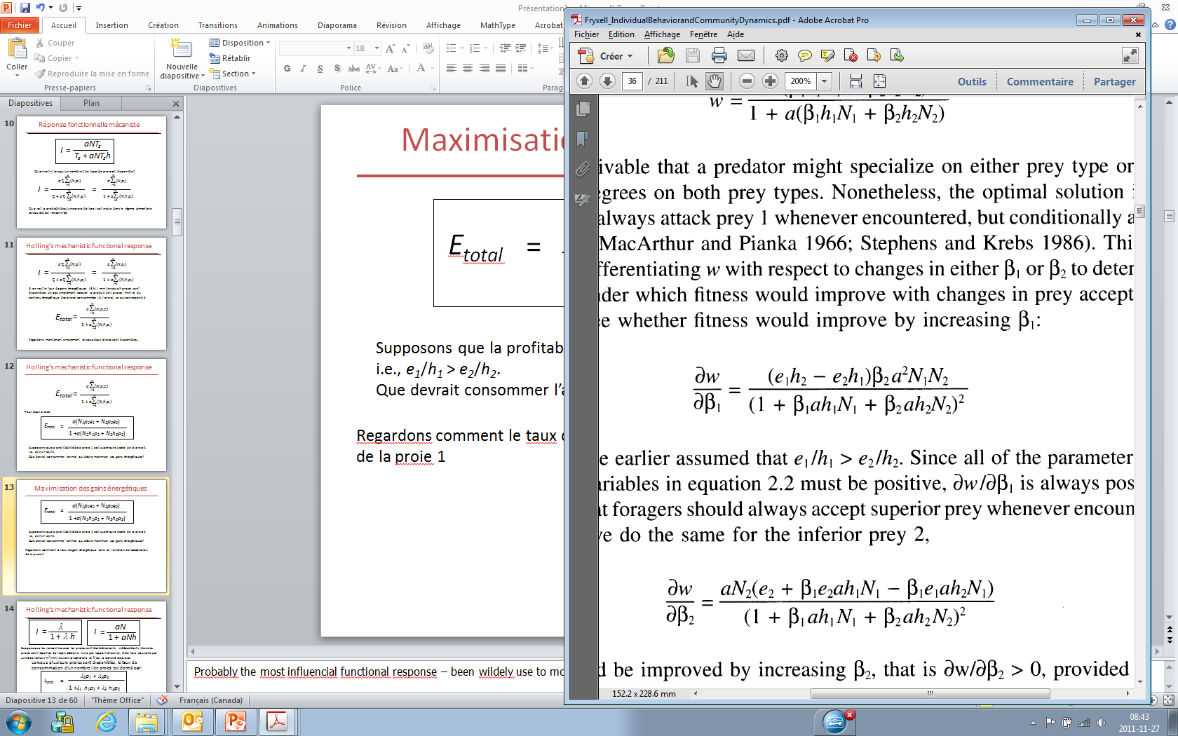
Maximization of energy intake rate:
the contingency model
a(N₁p₁e₁ + N₂p₂e₂)
E
=
1 +a(N₁h₁p₁ + N₂h₂p₂)
Let’s now evaluate how energy intake rate varies with the consumption of type 1 resource:
E
p₂
p₁
p₁
p₂
∂E
Because e₁/h₁ > e₂/h₂, can only be positive…
∂ p₁
… type 1 resource should therefore
always be consumed to maximize E

Slide 19
Maximization of energy intake rate:
the contingency model
a(N₁p₁e₁ + N₂p₂e₂)
E
=
1 +a(N₁h₁p₁ + N₂h₂p₂)
We can evaluate how energy intake rate varies with the consumption of type 2 resource :
∂E
p₁
p₁
=
∂ p₂
p₁
p₂
λ₁
∂E
Consuming type 2 resource increase energy gains (i.e., > 0) when…
∂ p₂
e₂
e₁h₂ - e₂h₁
Type 2 resource should not be consumed if the abundance of type 1 resource is relatively high
Encounter rate
N₁a <
Notes:
Probably the most influencial functional response – been wildely use to model carnivore-herbivore relationship

Slide 20
Maximization of energy intake rate:
the contingenty model
Energy gain rate
(kJ/min)
Decreasing profitability (kJ/min)
Change in energy gain rate following the successive addition of resource types in the diet, in order of decreasing profitability
5
i=1
Σ
a (N_{i}e_{i})
>
e₆
> …
>
e₁₀
E =
5
i=1
h₆
Σ
h₁₀
1 + a (N_{i}h_{i})

Slide 21
Maximization of energy intake rate:
the contingenty model
Optimal choice depends on the encounter rate with the optimal resource types
Change in the availability of the less profitable types does not influence the optimal diet
Associated with the principle of missed opportunity costs
A given resource type should always be consumed or ignored encountered, i.e., 0-1 rule

Slide 22
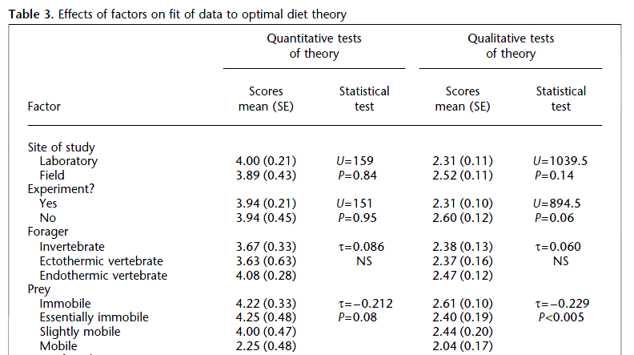
Maximization of energy intake rate:
the contingenty model
Échelle: 1-6*
Échelle: 1-3*
*Higher scores indicate higher support to optimal diet theory.
Sih et Christensen 2001, Anim. Behav. 61: 379-390

Slide 23
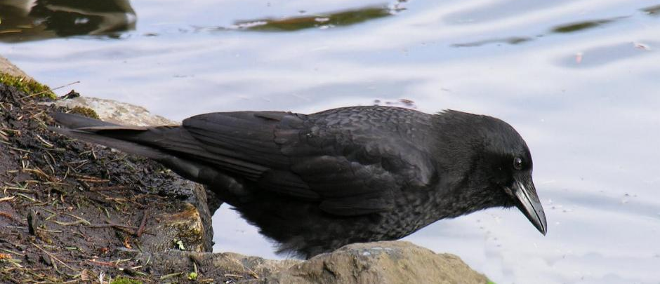
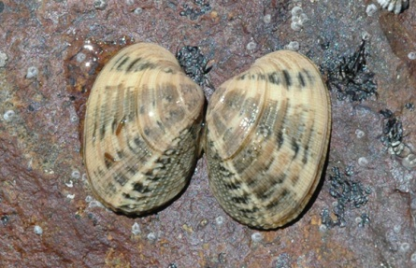
Maximization of energy intake rate:
the contingenty model
Northwester crows feeding on littleneck clams
Must find, then open the clams by dropping them on flat rock
(Corvus caurinus)
(Venerupis japonica)
Richardson and Verbeek (1986,
Ecology 67: 1219-26)

Slide 24
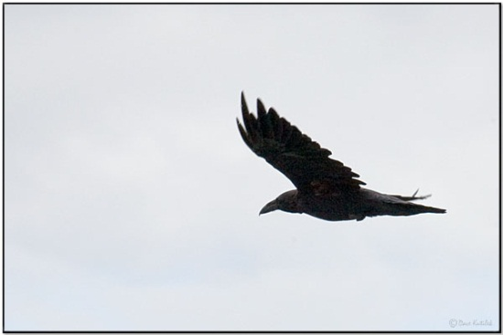
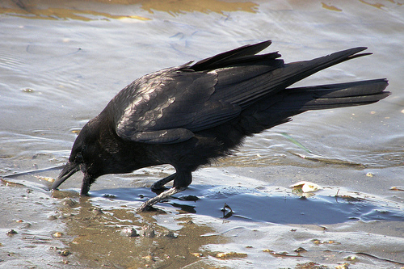
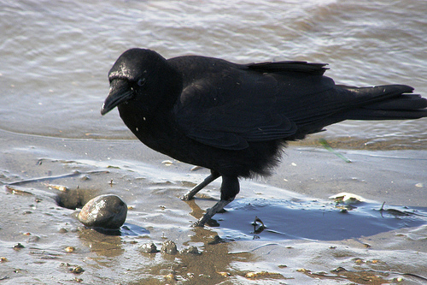
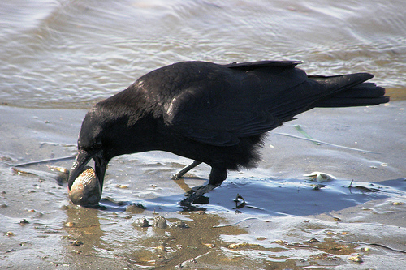
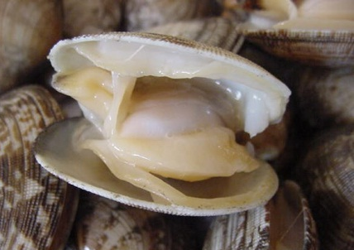
Maximization of energy intake rate:
the contingenty model
34.6 sec to find a clam
4.2 sec first drop flight
5.5 sec handling between drops
Flight costs > 4x higher than search and dig costs
Richardson and Verbeek (1986, Ecology 67: 1219-26)

Slide 25
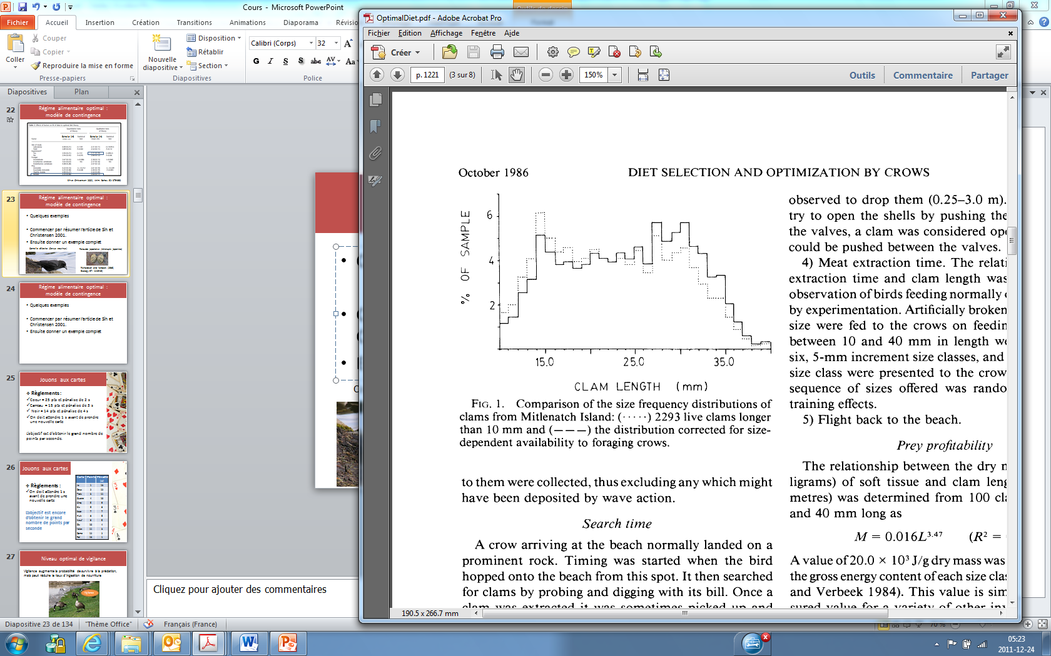
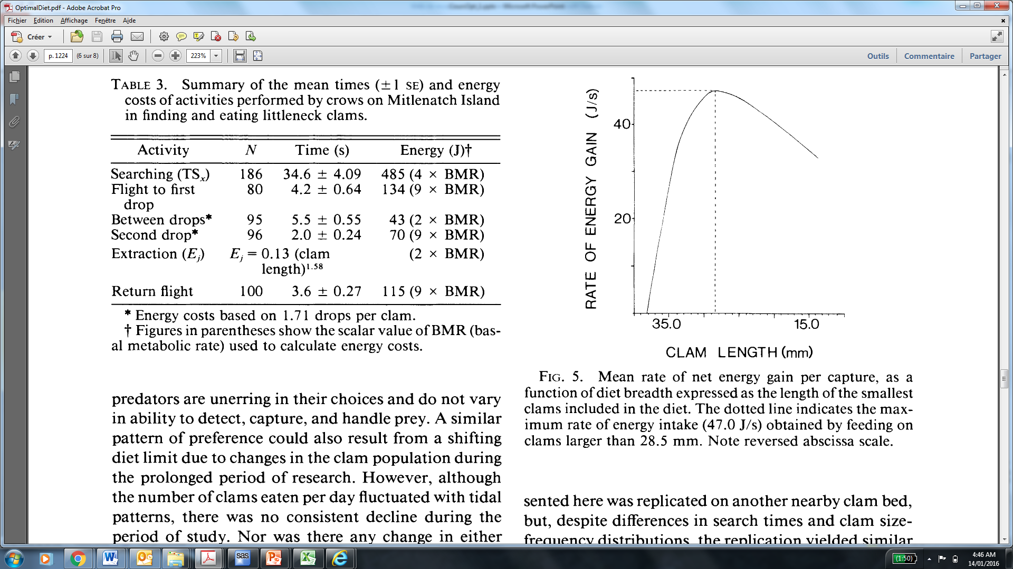
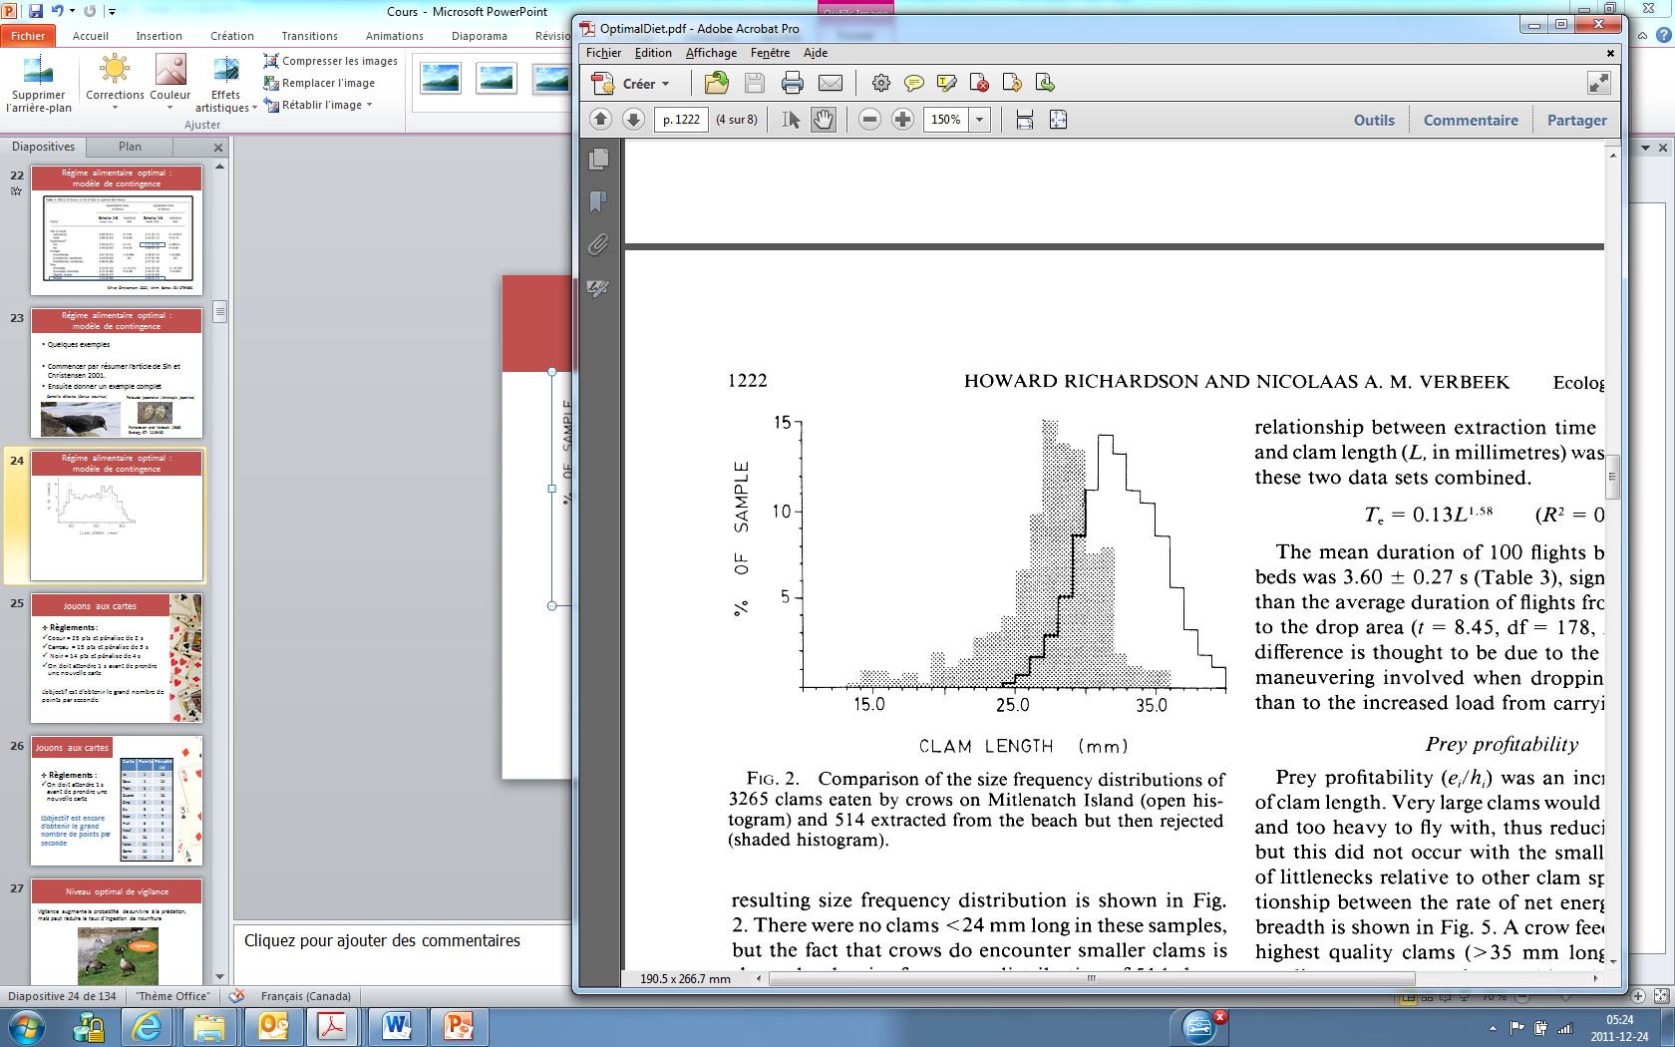
Maximization of energy intake rate:
the contingenty model
Availability
Should be
consumed
Consumed
Rejected
Clam length (mm)

Slide 26
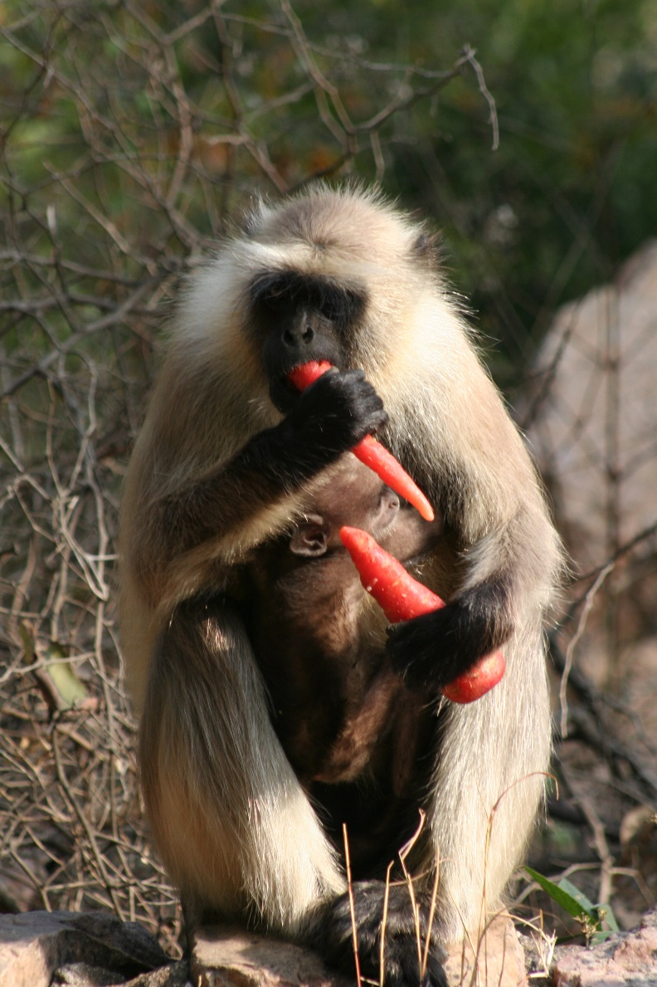
Maximization of energy intake rate:
the contingenty model
Some assumptions of the contingency model:
Omniscience
Successive encounters with resources are independent events (e.g., not distributed in patches)
No predation

Slide 27
Maximization of energy intake rate:
the contingenty model
Some assumptions of the contingency model:
Omniscience
Successive encounters with resource are independent events (e.g., not distributed in patches)
No predation

Slide 28

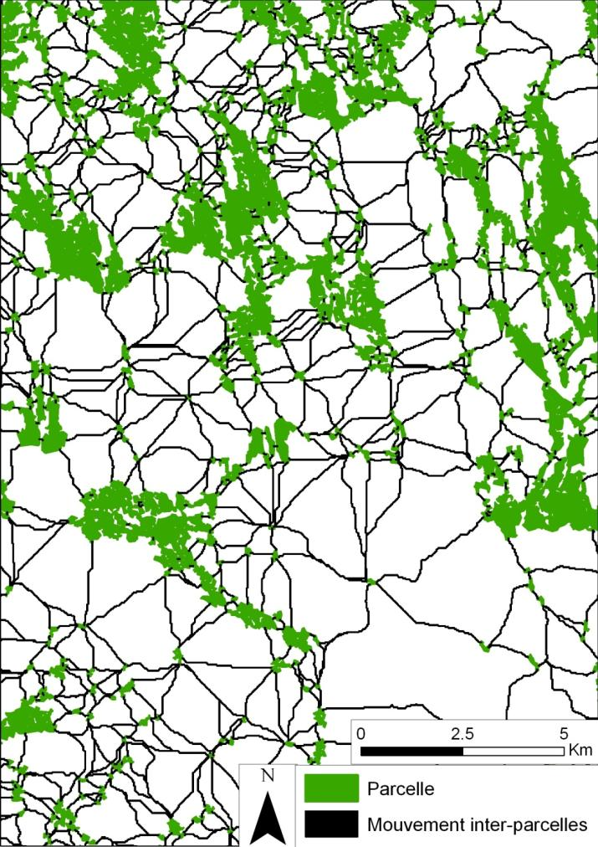
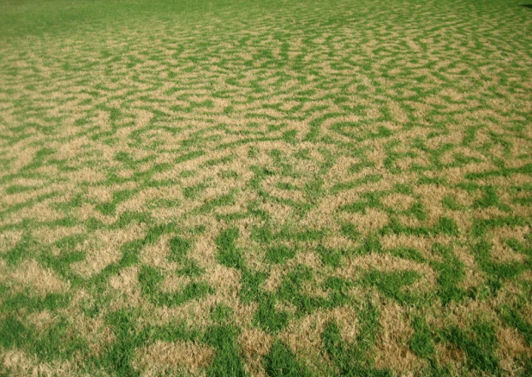
What if prey forage in a mosaic of food patches in which > 1 resource type is available?
© R. Du Toit

Slide 29

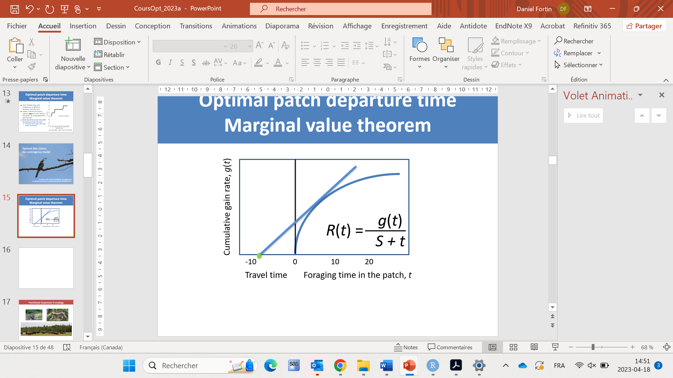

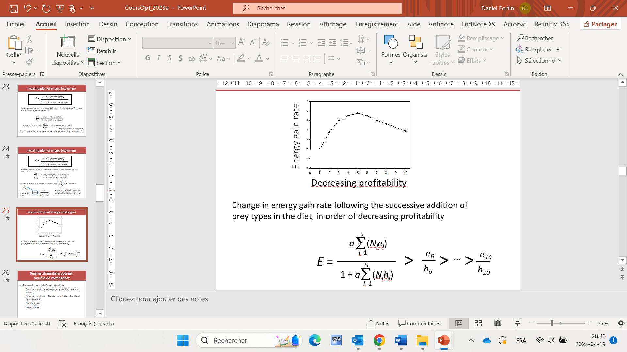
What if prey forage in a mosaic of food patches in which > 1 resource type is available?
t*
S
Marginal value theorem
Contingency model
t*
g(t*) depends on food choice
Should leave when: t* = – S + g(t*)
R(t*)
Find g(t*) given E*
When to leave the patch
© R. Du Toit
What to eat in the patch

Slide 30

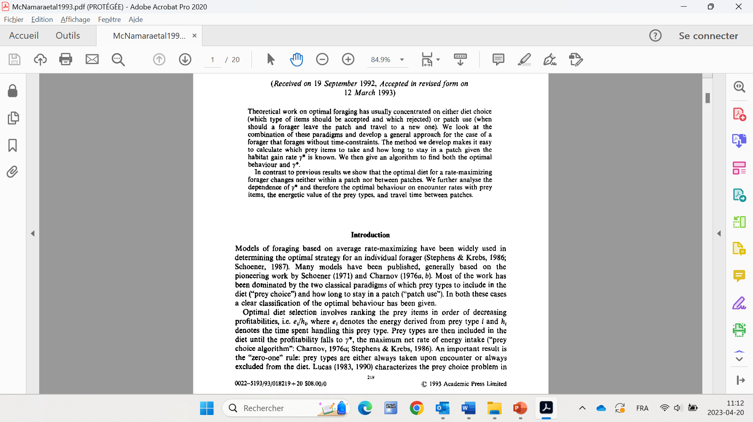
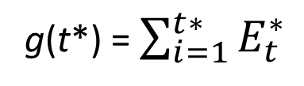
What if prey forage in a mosaic of food patches in which > 1 resource type is available?
t*
S
Marginal value theorem
Contingency model
…
t*
g(t*) = $\sum_{i=1}^{t∗}{E_{t}^{∗}}$

Slide 31
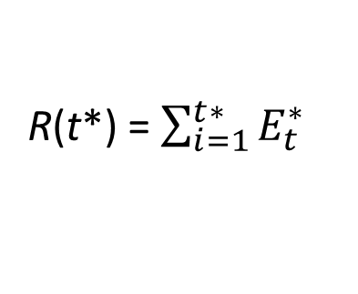
What if prey forage in a mosaic of food patches in which > 1 resource type is available?
t*
S
Marginal value theorem
Contingency model
t*
g(t*)
g(t*) = $\sum_{i=1}^{t∗}{E_{t}^{∗}}$
R(t*) = $\sum_{i=1}^{t∗}{E_{t}^{∗}}$
R(t*) =
S + t*
S + t*
When to leave the patch
© R. Du Toit
What to eat in the patch

Slide 32
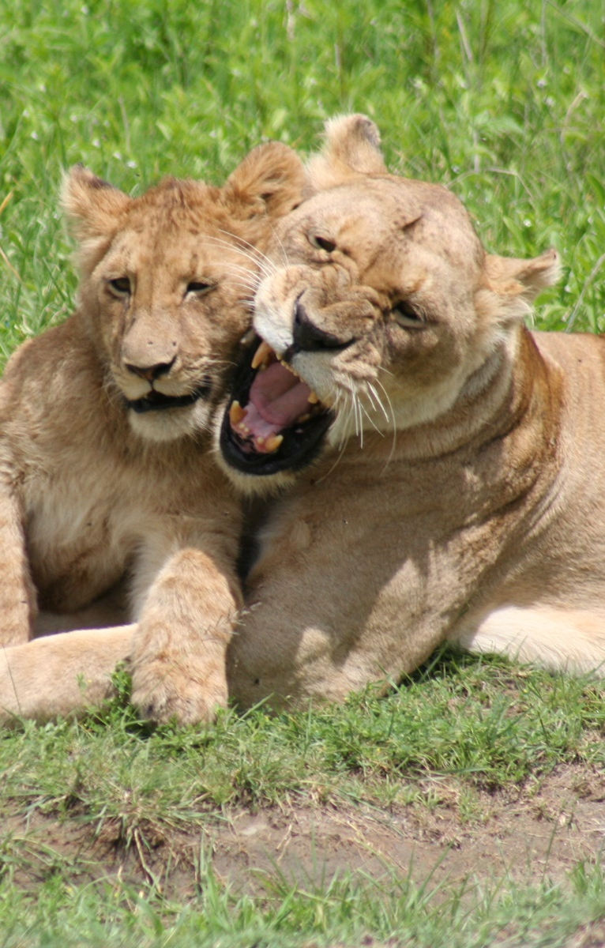
Maximization of energy intake rate:
the contingenty model
Some assumptions of the contingency model:
Omniscience
Successive encounters with resource are independent events (e.g., not distributed in patches)
No predation

Slide 33
What if a predator enters the system, and prey have access to refuges?
Refuge
t
S
R(t) =
T_{s} aN g(t)
R(t) =
T_{s} aN g(t)
aN g(t)
=
T_{s} + T_{h} + T_{r}
T_{f}
T_{s} + aNT_{s}t + T_{r}
1 + aNt + T_{r} /T_{s}
T_{s}: total time spent searching (min)
T_{h}: total time foraging in paches (min)
T_{r}: total time spent in refuges (min)
aN = λ: patch encounter rate (patches/min)

Slide 34
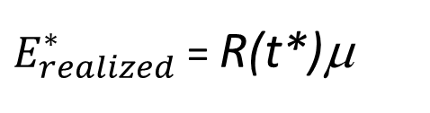
What if a predator enters the system, and prey have access to refuges?
Refuge
t
S
R(t) =
aN g(t)
μ = T_{s}μ_{s} + T_{h}μ_{h} + T_{r}μ_{r}
1 + aNt + T_{r} /T_{s}
T_{s} + T_{h} + T_{r}
μ : Probability of surviving to realize the gain
T_{s}: total time spent searching (min)
T_{h}: total time foraging in paches (min)
T_{r}: total time spent in refuges (min)
aN = λ: patch encounter rate (patches/min)
$E_{realized}^{∗}$= R(t*)μ
We can then find: , i.e., the currency to maximize.
μ_{s} : Probability of surviving when → searching food
μ_{h}: → foraging at a feeding station
μ_{r}: → staying in a refuge

Slide 35




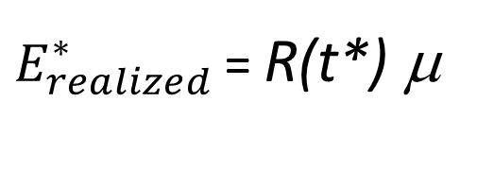
Example of how multiscale energy gain can be estimated over a short period of time
Prey
hide
$E_{realized}^{∗}$ = R(t*) μ
Forage with diminushing return in a patch
Move between resources patches
Use of refuge
Adjust T_{s}, T_{h}, T_{r} to obtain max(E_{realized}), given a total foraging time of 30 min, i.e., T_{s} + T_{h} + T_{r} = T_{f} = 30 min
Predator

Slide 36




Example of forager experiencing diminishing return
Yellow: 9/99
Green: 9/98
Allowed to draw a marble every 5 sec
Type | Marbles in bag | Points | Handling time (sec)
 | 10 | 20 | 20
 | 20 | 5 | 20
 | 70 | 0 | 0
N(t) = N_{green}(t) + N_{yellow} (t) + N_{black}
N(1) = 100 = 10 + 10 + 70
1/5 of drawing green or yellow…
at the begining

Slide 37
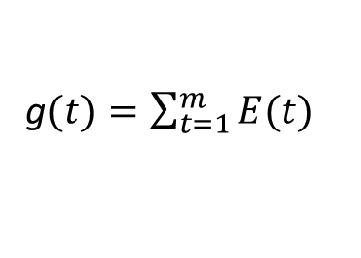
Example of forager experiencing diminishing return
λ(N₁(t-1) p₁)/N(t-1)
N₁(t) = N₁(t -1) – I₁(t-1)
N₁(t) = N₁(t-1) –
1 + λ[N₁(t-1) h₁p₁ + N₂(t-1) h₂p₂]/N(t-1)
λ(N₂(t-1) p₂)/N(t-1)
N₂(t) = N₂(t -1) – I₂(t-1)
N₂(t) = N₂(t-1) –
1 + λ[N₁(t-1) h₁p₁ + N₂(t-1) h₂p₂]/N(t-1)
x
N(t) = N₁(t) + N₂(t) + N_{Ø}
Assuming p₂ = 0
g (points)
x
N₁
λ[N₁(t-1) p₁e₁ + N₂(t-1) p₂e₂] / N(t-1)
E(t) =
Assuming p₂ = 0
1 + λ[N₁(t-1) h₁p₁ + N₂(t-1) h₂p₂] / N(t-1)
g$(t)=\sum_{t=1}^{m}{E(t)}$
Time (min)
Time (min)
λ : Encounter rate, i.e., number of marbles that can be drawn / min, excluding handling time
N_{i}(t) /N(t): Relative probability of encounter with a marble of type i item
p_{i}: Dichotomic variable indicating if type i marble is used (1) or not (0)
e_{i}: Number of points gained
h_{i}: Handing time (min)

Slide 38
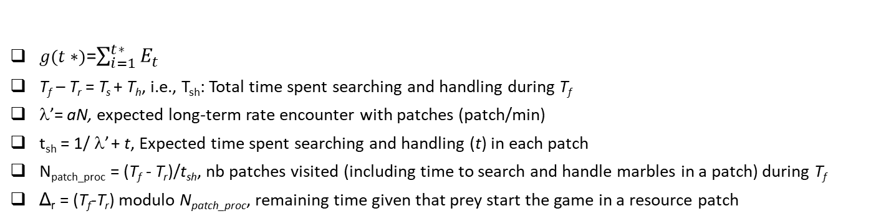
Inter-patch scale over relatively short periods of time
T_{f}
T_{f}: Total foraging time (min), i.e., game duration
t
Searching
Waiting in refuge
Incomplete
$g(t∗)$=$\sum_{i=1}^{t∗}{E_{t}}$
T_{f} – T_{r} = T_{s} + T_{h}, i.e., T_{sh}: Total time spent searching and handling during T_{f}
λ’= aN, expected long-term rate encounter with patches (patch/min)
t_{sh} = 1/ λ’ + t, Expected time spent searching and handling (t) in each patch
N_{patch_proc} = (T_{f} - T_{r})/t_{sh}, nb patches visited (including time to search and handle marbles in a patch) during T_{f}
Δ_{r} = (T_{f}-T_{r}) modulo N_{patch_proc}, remaining time given that prey start the game in a resource patch
If (Δr - t < 0) → Prey did not have the time to completely handle the last patch
N_{patch_fully} = nb with resources fully handled, round down (N_{patch_proc})
t_{last} = Time spent foraging (i.e., searching and handling marbles) last patch = Δ_{r}
g_{m}
g_{total} = g(m-1) N_{patch_fully} + g_{m}
T_{h1} = t N_{patch_fully} + t_{last}
T_{s} = (1/ λ₁)N_{patch_fully}

Slide 39
Inter-patch scale over relatively short periods of time
T_{f}
t
Searching
Waiting in refuge
Incompletesearch
$g(t∗)$=$\sum_{i=1}^{t∗}{E_{t}}$
T_{f} – T_{r} = T_{s} + T_{h}, i.e., T_{sh}: Total time spent searching and handling during T_{f}
λ’= aN, expected long-term rate encounter with patches (patch/min)
t_{sh} = 1/ λ’ + t, Expected time spent searching and handling (t) in each patch
N_{patch_proc} = (T_{f} - T_{r})/t_{sh}, nb patches visited (including time to search and handle marbles in a patch) during T_{f}
Δ_{r} = (T_{f}-T_{r}) modulo N_{patch_proc}, remaining time given that prey start the game in a resource patch
If (Δr - h_{partch1} ≥ 0) → Prey had the time to completely handle the last patch visited
N_{patch_fully} = round up (N_{patch_proc}), nb with resource patches fully handled
t_{search} = Δr – h_{patch}
g_{total} = g(t) N_{patch_fully}
T_{h} = t N_{patch_fully}
T_{s} = (1/ λ₁) (N_{patch_fully} – 1) + t_{search}

Slide 40

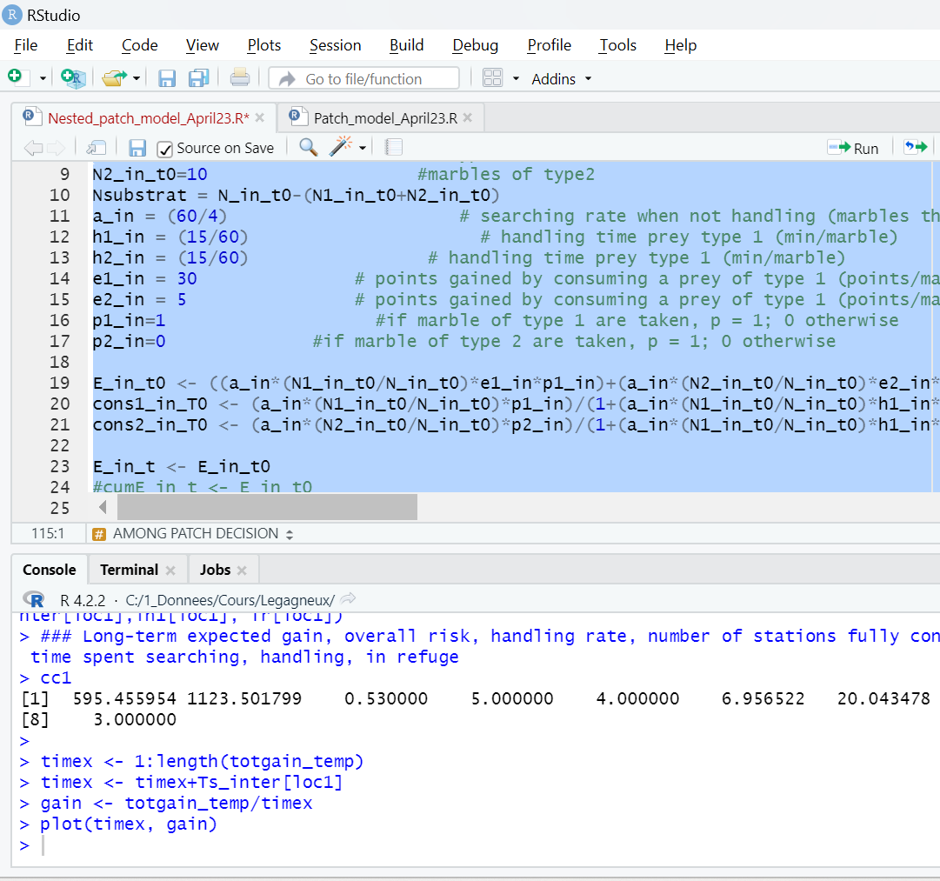
Optimal combination of T_{s}, T_{h} and T_{r}, given the optimal diet and residence time under predation risk, as identified numerically

Slide 41
Describe field experiment or experimental conditions…
Basic parameters
Tf <- 30 # game duration
######################## start the game in a patch ########################
####################### WITHIN PATCH DECISION ################################
N_in_t0=50 # total number of marbles at a given station
N1_in_t0=10 #marbles of type 1 simply to estimate the gain function
N2_in_t0=10 #marbles of type2
Nsubstrat = N_in_t0-(N1_in_t0+N2_in_t0)
a_in = (60/5) # searching rate when not handling (marbles that can be drawn /min)… i.e., can uncover 12 squares /min, i.e., one every 5 sec
h1_in = h2_in = (15/60) # handling time prey type 1 (min/marble)
e1_in = 40 # points gained by consuming a prey of type 1 (points/marble)
e2_in = 5 # points gained by consuming a prey of type 1 (points/marble)
p1_in=1 #if marble of type 1 are taken, p = 1; 0 otherwise
p2_in=1 #if marble of type 2 are taken, p = 1; 0 otherwise
####################### AMONG PATCH DECISION ################################
a <- 30*23 #area search rate (m2/min), i.e., width*speed
N1 <- (200/(120000)) # (200 patches; 30 participants, environ 12 ha; 120 000 m2, distance moy entre patches = 12.25 m (=1/(2*((200/120000)^0.5))) = 315 x 315 m) ###### patch density (patches/m2) if I put N1 = 1/a, N2 = 0.3/a, then 1 type is best instead of
N2 <- N1 ###### density of patch type 2 (patches/m2)
mus <- 0.5 ### survival probability when travelling between patches
muh <- mus ### survival probability when at a patches (i.e., when handling food)
mur <- 0.9 ### survival probability when in refuge
p1 <- 1
p2 <- 0 #p2=0 because only one type of resource patch
In this case, consuming only p1 is the best choice, and 6 min should be spent in refuges
"Eall", "E", "mu", “t", "NbPatch_consumed", "Ts","Th","Tr“
Avec p2 = 0 → 807.588752 1392.394399 0.580000 5.000000 4.000000 3.478261 20.521739 6.000000
Avec p2 = 1 → 787.629605 1357.982078 0.580000 5.000000 4.000000 3.478261 20.521739 6.000000

Slide 42
Describe field experiment or experimental conditions…
Basic parameters
Tf <- 30 # game duration
######################## start the game in a patch ########################
####################### WITHIN PATCH DECISION ################################
N_in_t0=50 # total number of marbles at a given station
N1_in_t0=10 #marbles of type 1 simply to estimate the gain function
N2_in_t0=10 #marbles of type2
Nsubstrat = N_in_t0-(N1_in_t0+N2_in_t0)
a_in = (60/10) # searching rate when not handling (marbles that can be drawn /min)… i.e., can uncover 12 squares /min, i.e., one every 10 sec
h1_in = h2_in = (15/60) # handling time prey type 1 (min/marble)
e1_in = 40 # points gained by consuming a prey of type 1 (points/marble)
e2_in = 5 # points gained by consuming a prey of type 1 (points/marble)
p1_in=1 #if marble of type 1 are taken, p = 1; 0 otherwise
p2_in=1 #if marble of type 2 are taken, p = 1; 0 otherwise
####################### AMONG PATCH DECISION ################################
a <- 30*23 #area search rate (m2/min), i.e., width*speed
N1 <- (200/(120000)) # (200 patches; 30 participants, environ 12 ha; 120 000 m2, distance moy entre patches = 12.25 m (=1/(2*((200/120000)^0.5))) = 315 x 315 m) ###### patch density (patches/m2) if I put N1 = 1/a, N2 = 0.3/a, then 1 type is best instead of
N2 <- N1 ###### density of patch type 2 (patches/m2)
mus <- 0.5 ### survival probability when travelling between patches
muh <- mus ### survival probability when at a patches (i.e., when handling food)
mur <- 0.9 ### survival probability when in refuge
p1 <- 1
p2 <- 0 #p2=0 because only one type of resource patch
In this case, consuming only p1 is the best choice, and 6 min should be spent in refuges
"Eall", "E", "mu", “t", "NbPatch_consumed", "Ts","Th","Tr“
Avec p2 = 0 → 600.115375 1034.681681 0.580000 5.000000 4.000000 3.478261 20.521739 6.000000
Avec p2 = 1 → 622.892674 1073.952887 0.580000 7.000000 3.000000 2.608696 21.391304 6.000000
Notes:
2-3 min dans chacune des parcelles

Slide 43
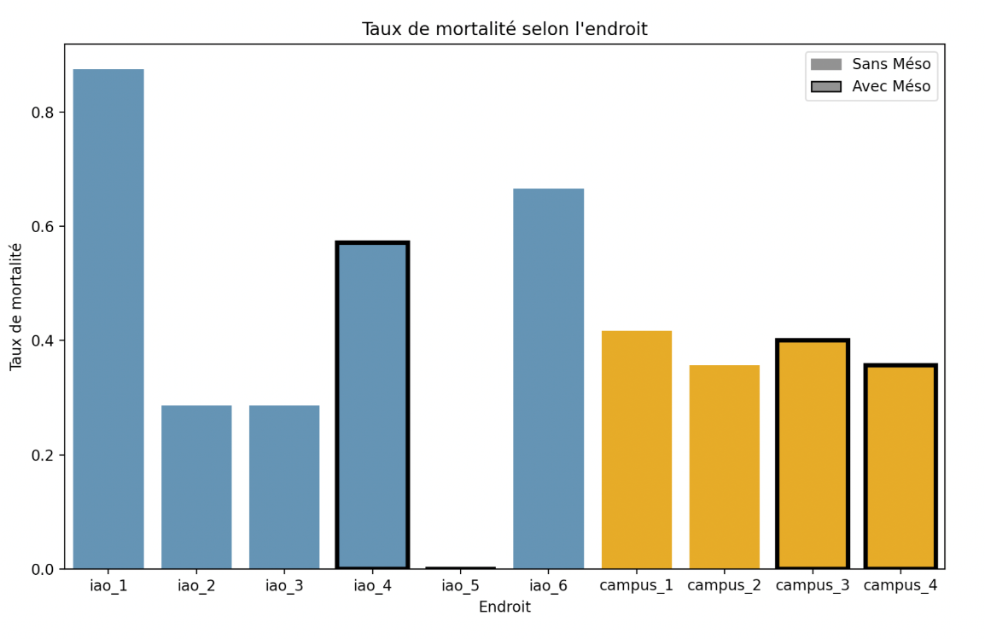
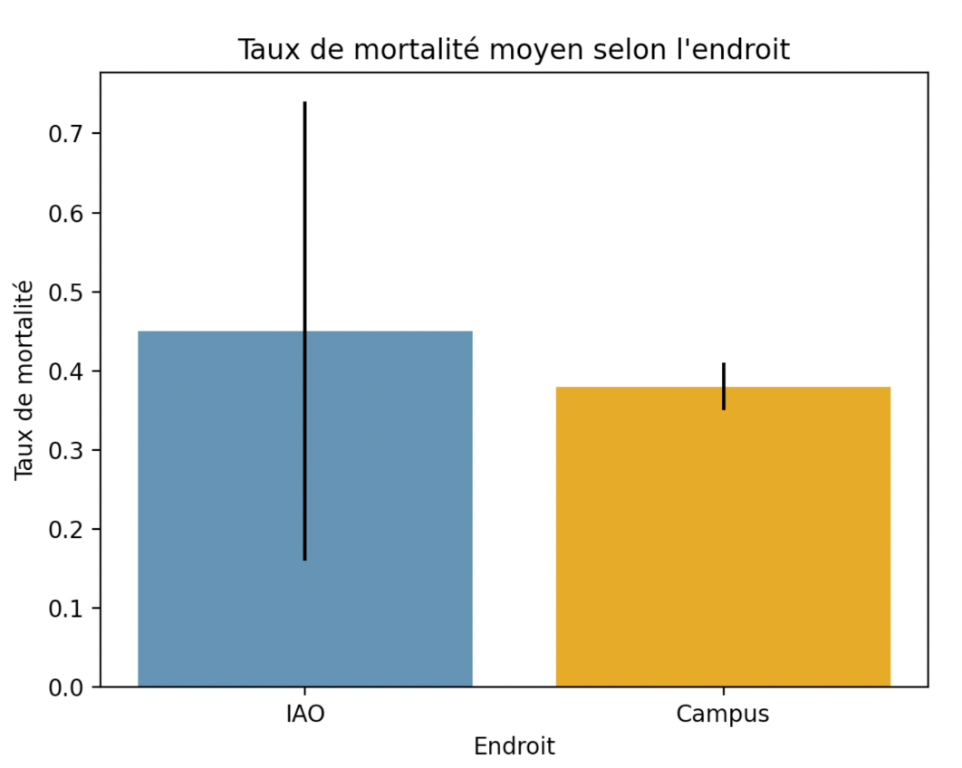
ouston and McNamara 2013
Survival: 55 and 60%

